Slide 1
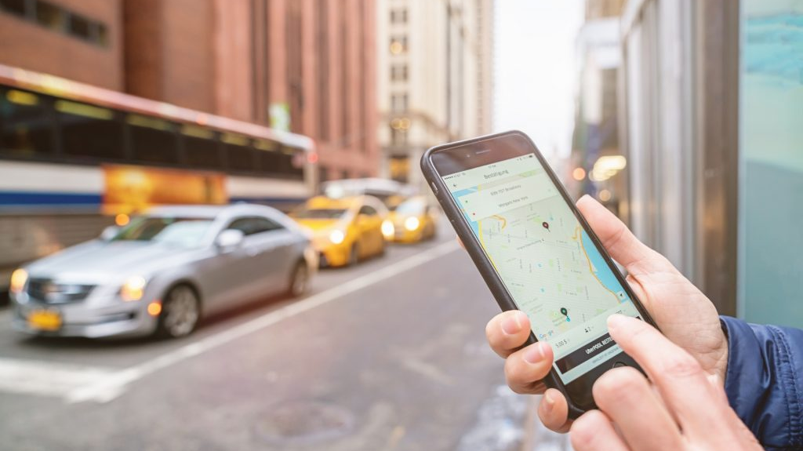
Metrocar Data Analysis
-Sanchita Neupane
-Melek Çimen
Notes:
Lesson Title slide: Do Now Activity This is the slide that displays as students enter your zoom meeting. Design a Do Now Activity that can be completed in 1-3 minutes. Examples - Do Now Activities 1. Reinforce already-mastered skills => e.g., “Solve the following problem using a JavaScript iterator.” 2. Emphasize critical thinking => e.g., “Look at the google results webpage (provide visual). Where do you think the developers might have used a .map() method?” 3. Comparison => e.g., “Look at this React class component with lifecycle methods vs. this functional component that makes use of Hooks (show visual). List at least 3 differences you notice between the two.” 4. Forward-thinking => e.g., “In today’s lesson, we will be discussing JavaScript testing. List 1-3 ways you believe writing tests will influence our code quality and the process of building an app.” 5. Introductory reading with prompts / questions => e.g., “Start reading this short blurb / article / blog post about X. Write down at least one thing you learned and put it in the chat.” 6. Real world problem => e.g., “Based on what you have learned so far, what are 1-3 strategies you will use in your career as web developer to reduce the number of errors and mistakes in your code?” 7. A riddle => e.g., "The more you code, the more of me there is. I may be gone for now but you can’t get rid of me forever. What am I?"

Slide 2

Introduction
Metrocar company is one of the top platform in the USA that connects drivers and riders through a mobile application. The main objective of this analysis is how can we improve customer journey within Metrocar.
Our analysis is based on one year data spanning from March 2021 to April 2022. We have utilized SQL, Google sheet and Tableau for data analysis.
Funnel analysis is used to track customer journey stages.
Notes:
Objectives slide: Write 1-3 objectives based on your target learning outcome or topic. Ensure that all objectives are... Specific, Measurable, Achievable, Realistic, and Time-bound.

Slide 3
Objectives and Business Questions:
Drop- off points in the customer journey.
Prioritizing marketing platforms.
Lowest conversion stage analysis.
Factors contributing to ride cancellations and negative ratings.
Reasons behind declined payments.

Slide 4

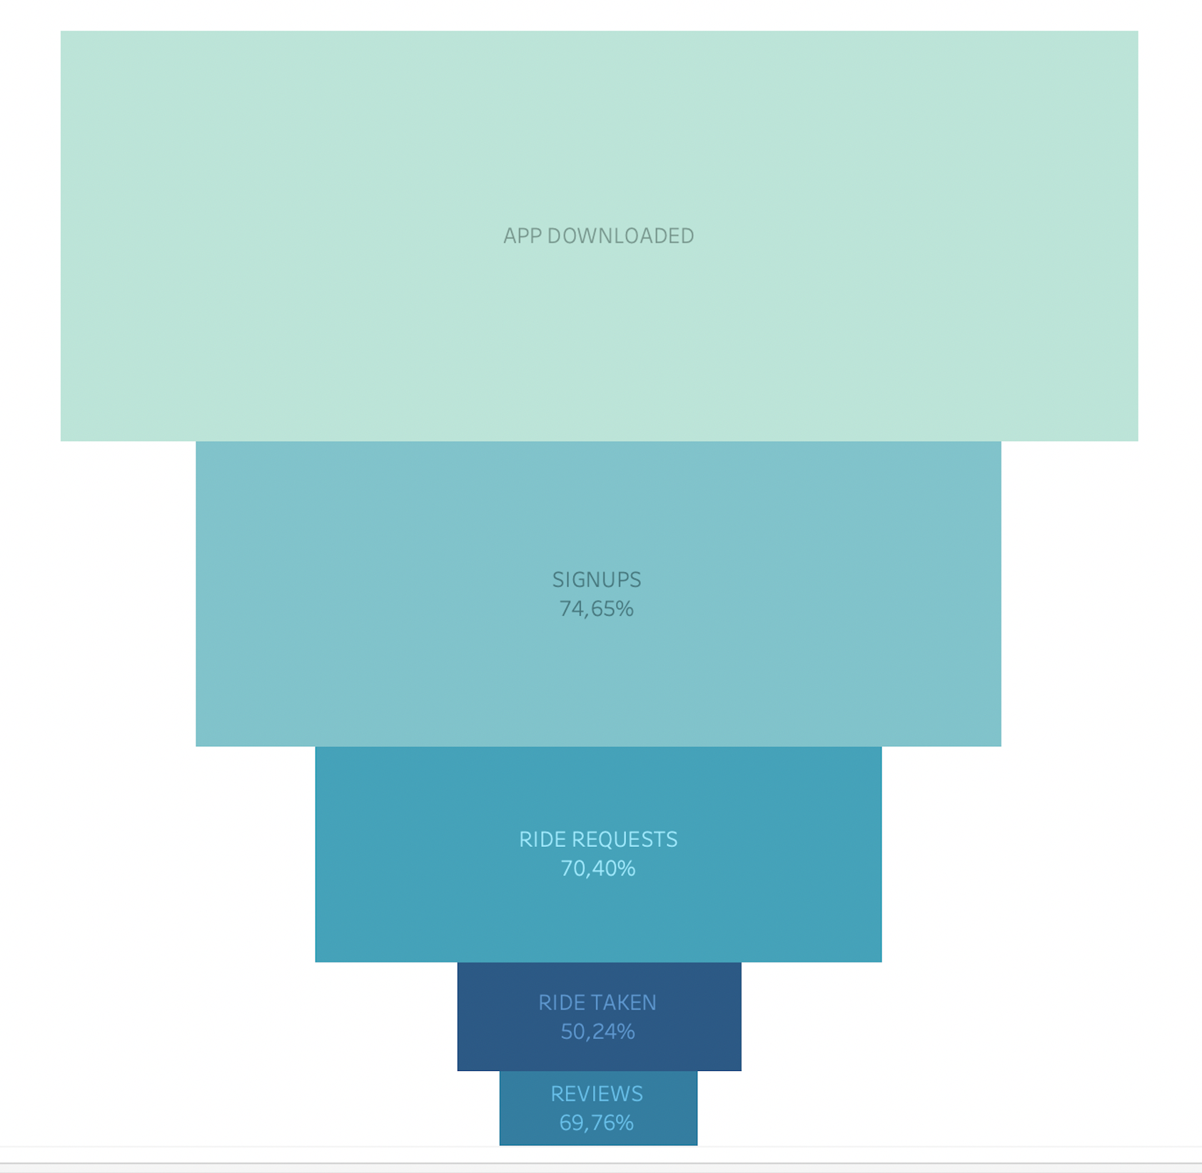
Funnel Analysis
Conversion rate as per the stage of funnel which is decreasing.
Drop off rate in ride taken is higher as per the stage of funnel compared to the top funnel.
Highest drop off is from app downloads to the ride taken which is almost 50%. So, the company should focus on this stage.
Notes:
Lesson Bullet List slide: Option #2 6 x 6 Rule: No more than 6 bullets with 6 words per bullet Don’t put every word you intend to speak on your slide. Minimize slide content Keep slides simple, with no more more than 1-3 items on them

Slide 5
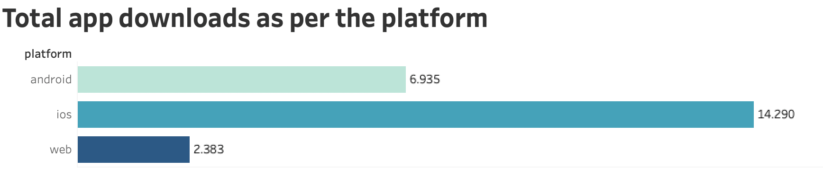
Platforms Focused and Usage Insights
The app downloaded by IOS and android is relatively more than web.
IOS is the most utilized platform, followed by Android platforms due to higher user engagement.
Funnel analysis of Platform also shows that the less used platform is web in all the stages of funnel.
Prioritize app optimization for IOS and Android platforms.

Slide 6
Addressing Lowest Conversion Stage
The ride completed stage of the funnel exhibits lowest conversion rate.
Out of 12406 ride requests, only 6233 were completed, resulting in a nearly 50% drop-off.
Prolonged wait times for ride acceptance identified as a major issue.
Conduct driver satisfaction survey and offer good incentives for performance.

Slide 7
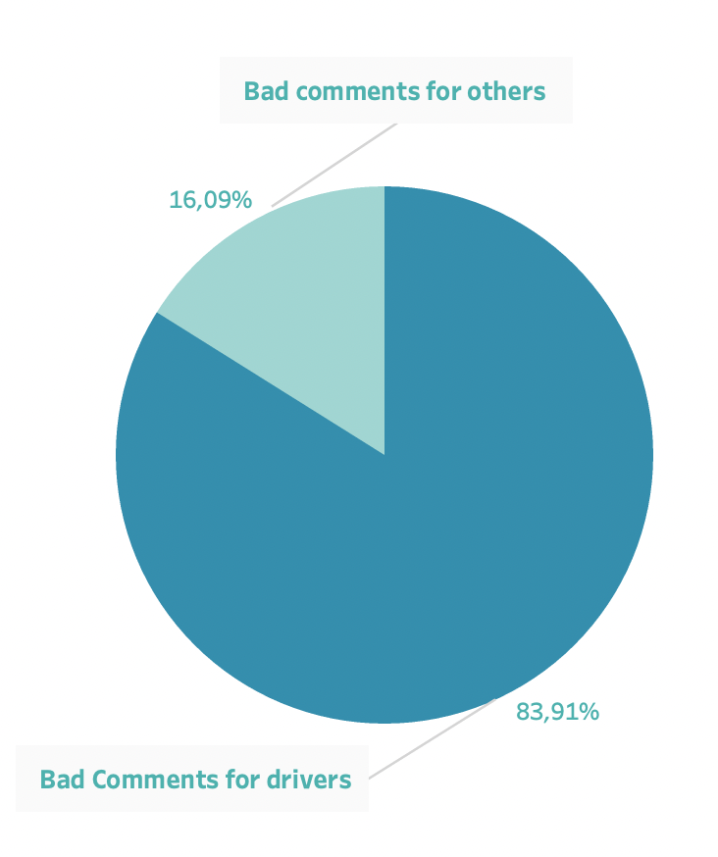
Improving Driver Behavior and Service Quality
Analysis reveals significant negative feedback directed towards drivers.
Out of 100% nearly 84% were for the drivers which were related with their behavior.
Implement driver training program which are related with behavior and introduce incentives, and improve feedback mechanisms.

Slide 8
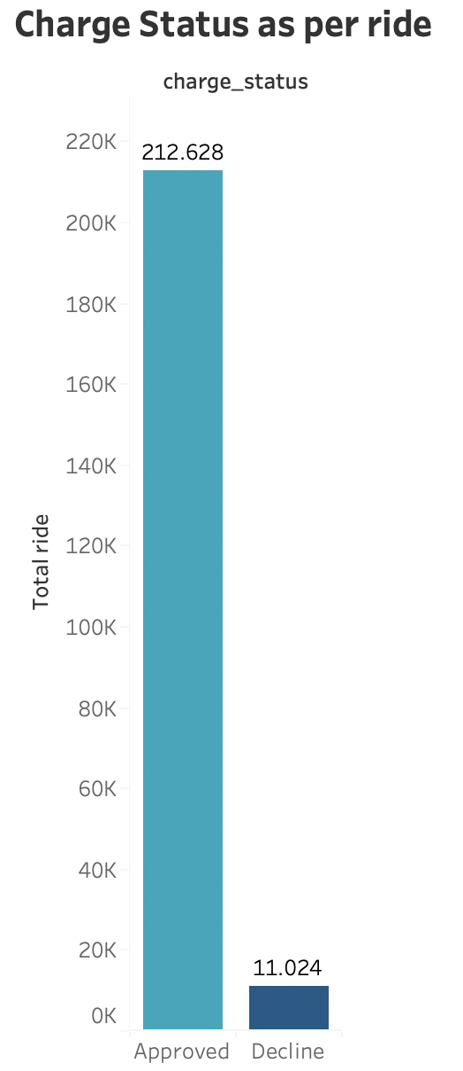
Ensuring Seamless Transactions
Even though the ride were completed in some cases the payments were declined.
The reason might include expired cards, insufficient funds and technical glitches.
Make secure and diverse payment methods, verify payments directly with banks.

Slide 9
Strategies for Enhancement
To optimize ride experience, we recommend implementing advanced driver tracking for transparency and offer performance- based incentives to reduce cancellations.
For improving driver related issue, offer training programs for drivers and introduce incentives for high-rated drivers.
Enhance IOS and Android app experience and remove web platforms. It can streamline resources and improve efficiency
Update payment methods for seamless transactions and integrate bank verification to reduce declined payments.
Offer discounts on first ride to attract new users.
Simply review system for user-friendliness and encourage feedback with one-click review options.

Slide 10
Conclusions
Implementation of recommended strategies to enhance user experience.
Anticipated outcomes: Expect improved customer satisfaction, heightened retention, and amplified conversion rates.
Next Steps: Proceed with action plan implementation and maintain continuous monitoring for effectiveness.

Slide 11
THANK YOU!
THANK YOU!

